Slide 1
Mind Matter Series
Behavior/Action
Malvika Behl, Ph.D., LPC, School Counselor

Slide 2
Malvika Behl is a Licensed Professional Counselor (LPC) in Texas and a School Counselor in Ohio. She has been in the field of counseling since about 2013 with a Masters degree in Counseling and a PhD in Counselor Education and Supervision. She has been working with adults and children. Since 2018, she has been working with families and children diagnosed with Specific Learning Disabilities (SLD). She has been doing researching mental health of adults, families, and children with SLD. She has presented on the mental health of individuals with SLD locally, state level, nationally, and internationally.

Slide 3
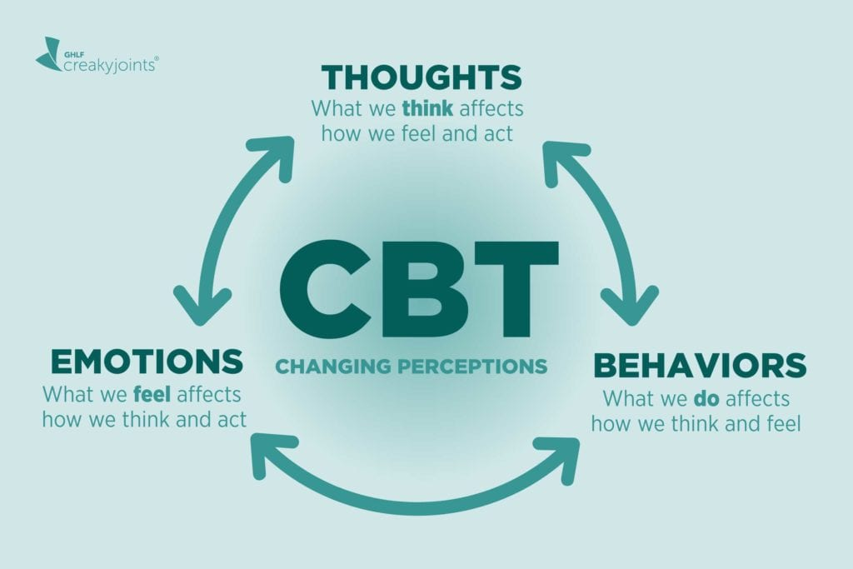
Cognitive Behavioral Theory

Slide 4
What are Behaviors?
Behaviors are your response to a situation. Behaviors include actions such as saying something or doing something (or, choosing not to do something).

Slide 5
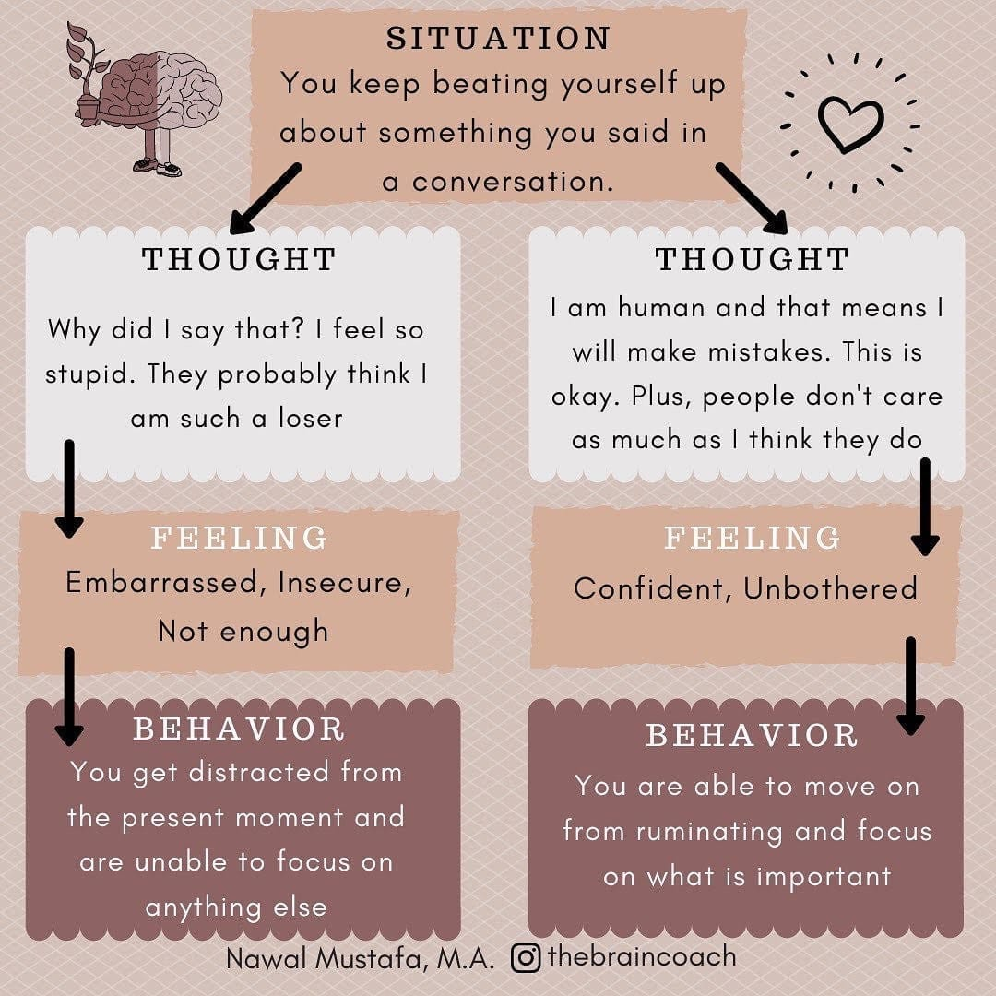

Slide 6
CORE BELIEFS
INTERMEDIATE BELIEFS
The central ideas about self and the world
The most fundamental level of belief
They are global, rigid, and overgeneralized
Examples of dysfunctional core beliefs:
“I am unlovable”
“I am inadequate”
“The world is a hostile and dangerous place”
Consist of assumptions, attitudes, and rules
Influenced in their development by the core beliefs
Examples of dysfunctional intermediate beliefs:
“To be accepted, I should always please others.”
“I should be excellent at everything I do to be considered adequate.”
“It is best to have as little as possible to do with people.”
Notes:
Underlying beliefs shape the perception and interpretation of events. Belief systems or schemas take shape as we go through life experiences. They are defined as templates or rules for information processing that underlie the most superficial layer of automatic thoughts. Beliefs are understood at two levels in CBT:

Slide 7
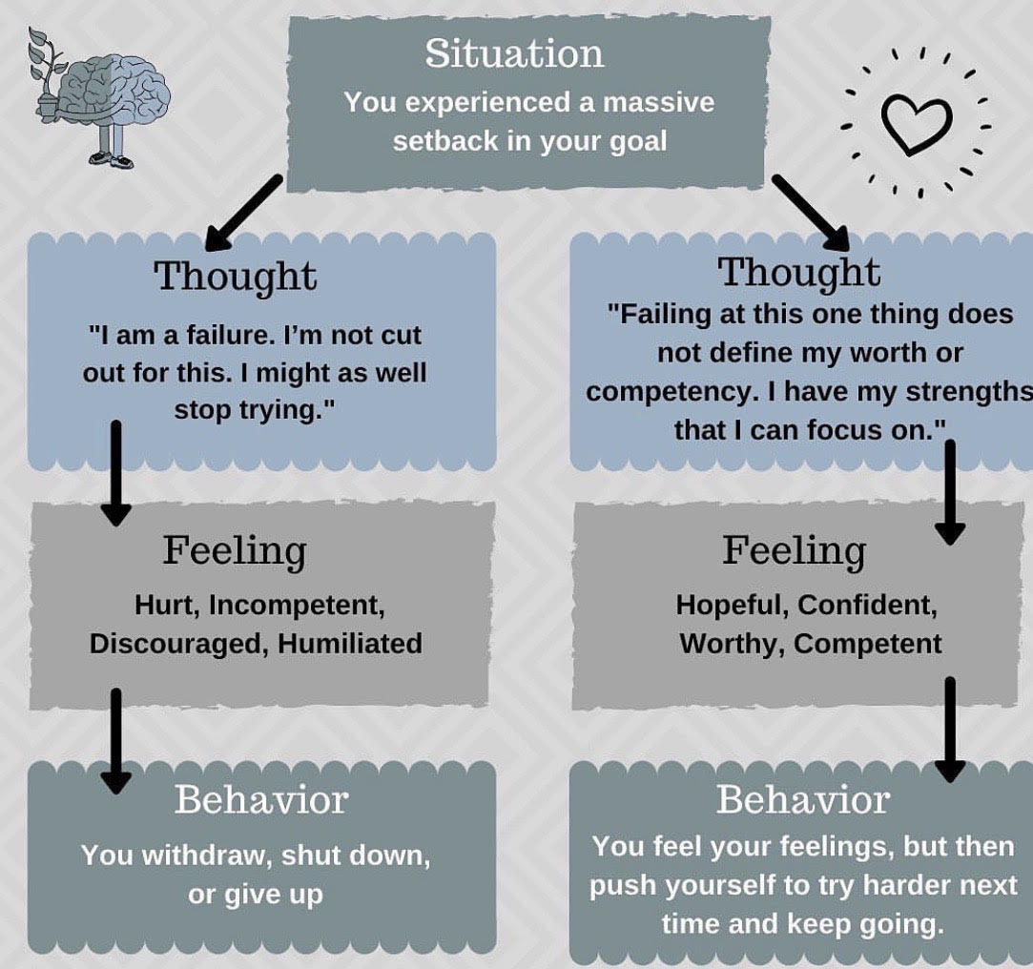

Slide 8
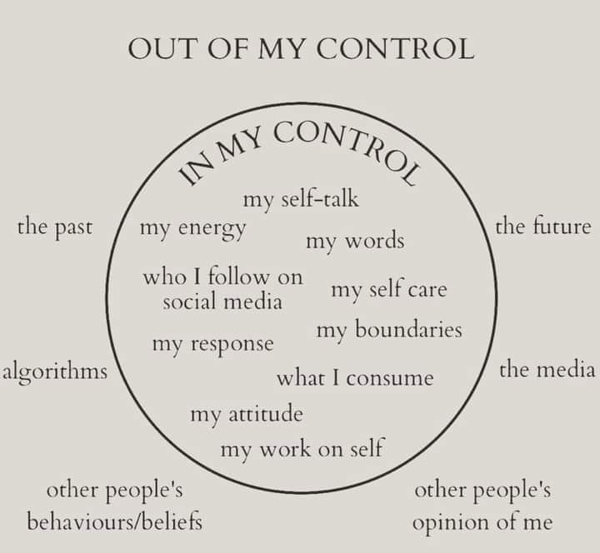
CONTROL VS. OUT OF OUR CONTROL

Slide 9
CONNECTING THOUGHTS, FEELINGS, AND BEHAVIOR
Identifying Coping skills
Using I-Statement
Completing thought journal
Identifying triggers and connecting coping skills

Slide 10
Hum your favorite song
Doodle on paper
Draw a picture
Color a coloring page
Clean something
Meditate
Use a stress ball
Dance
Write a letter
Look at pictures you’ve taken
Make a gratitude list
List your positive qualities
Do something kind
Give someone a hug
Put a puzzle together
Do something you love
Build something
Play with clay
Hug a stuffed animal
Rip paper into pieces
Play an instrument
Watch a good movie
Take pictures
Garden
Write a list
Keep a positive attitude
Schedule time for yourself
Blow bubbles
Write a positive note
Chew gum
Paint your nails
Write a story
Blog
Read a joke book
Write a poem
Drink cold water
Draw cartoons
Read a magazine
Write a thank you note
Count to 100
Make a list for the future
Read inspirational quotes
Compliment yourself
Visualize a stop sign
Laugh
Smile in the mirror
Smile at others
Do schoolwork
Look at animal pictures
Hyperfocus on an object
Notice 5 things you can see
Paint with water colors
Use a relaxation app
Watch a funny video
Drink some tea
Cook or bake
Plan a fun trip
Use an I-statement
Identify your emotions
Express your feelings to someone
Write down your thoughts
Identify a positive thought
Make your day’s schedule
List 10 positives about you
Ask yourself, “What do I need right now?”
Tell someone you are thankful for them
Pet an animal
Make a list of choices
Ask an adult for help
Organize something
Play a card game
Listen to nature sounds
Sit and relax all your muscles
Ask for a break
Take deep breaths
Do a positive activity
Play sports
Think of something funny
Take a quick walk
Practice yoga
Stand up and stretch
Listen to music
Take a time out
Slowly count to ten
Use positive self-talk
Say something kind to
yourself
Talk to a friend
Talk to an adult
Close your eyes and relax
Say, “I can do this”
Visualize your favorite place
Think of something happy
Think of a pet you love
Think about someone you love
Get enough sleep
Eat a healthy snack
Read a good book
Set a goal
Jog in place
Write in a journal

Slide 11
THOUGHT RECORD/ JOURNAL

Slide 12
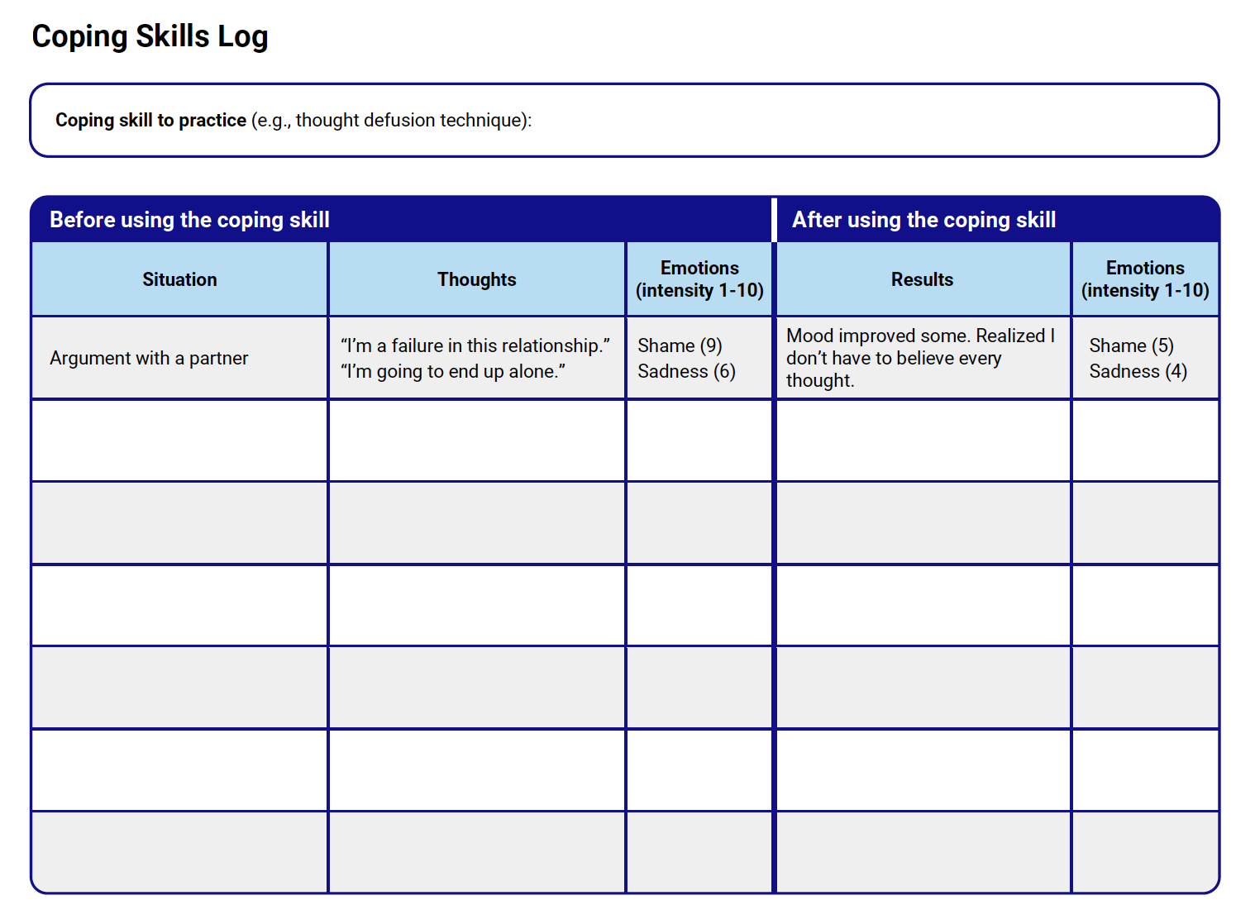
COPING SKILLS LOG

Slide 13
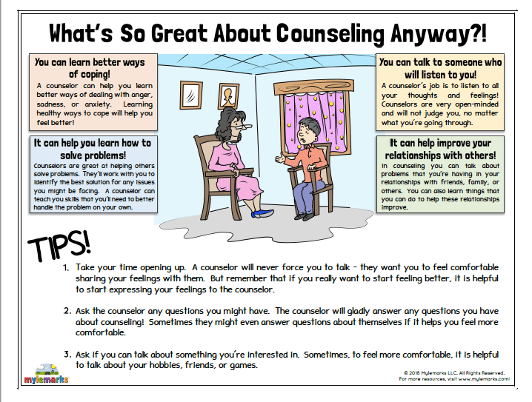

Slide 14
REFERENCE
https://www.ncbi.nlm.nih.gov/books/NBK470241/
https://www.thepathway2success.com/100-coping-strategies-for-anger-anxiety-and-more/
Therapistaid.com

