Slide 1
Mind Matter Series
Emotions
Malvika Behl, Ph.D., LPC, School Counselor

Slide 2

Malvika Behl is a Licensed Professional Counselor (LPC) in Texas and a School Counselor in Ohio. She has been in the field of counseling since about 2013 with a Masters degree in Counseling and a PhD in Counselor Education and Supervision. She has been working with adults and children. Since 2018, she has been working with families and children diagnosed with Specific Learning Disabilities (SLD). She has been doing researching mental health of adults, families, and children with SLD. She has presented on the mental health of individuals with SLD locally, state level, nationally, and internationally.

Slide 3

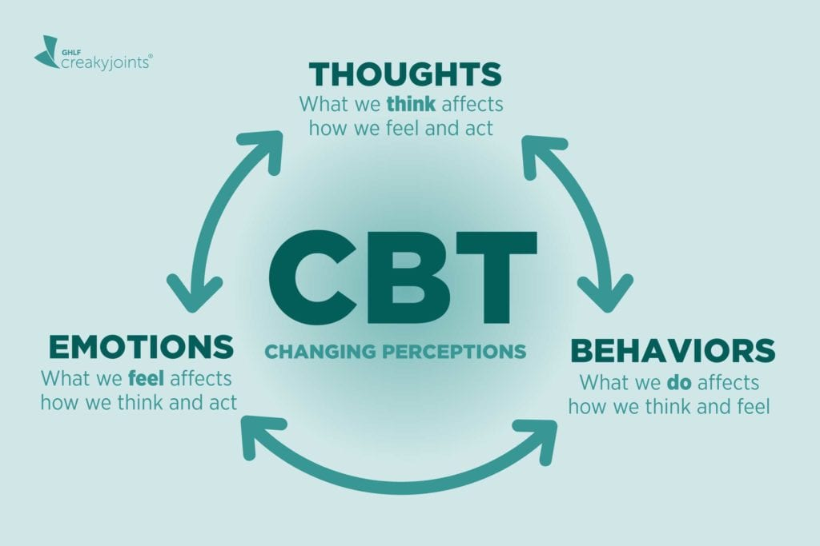
Cognitive Behavioral Theory

Slide 4

What are Emotions?
Emotions are psychological states comprised of thoughts, feelings, physiological changes, expressive behaviors, and inclinations to act

Slide 5
COMMON MYTHS ABOUT EMOTIONS
Myth #1: There is a right way to feel in every situation.
Myth #2: When I let others know I am feeling bad it shows I am weak or flawed.
Myth #3: All negative emotions will keep on increasing in intensity if I do not act
now.
Myth #4: Negative emotions are bad and destructive.
Myth #5: All emotions happen spontaneously for no reason.
Myth #6: Some emotions are completely stupid and useless.
Myth #7: If others do not agree with how I feel then I must be wrong.
Myth #8: Other people are the best at knowing how I am feeling.
Myth #9: All painful emotions should be ignored because they are unimportant.
Myth #10: Feeling negative or painful emotions means I am bad.

Slide 6
Types of emotions
Pleasant
Unpleasant

Slide 7
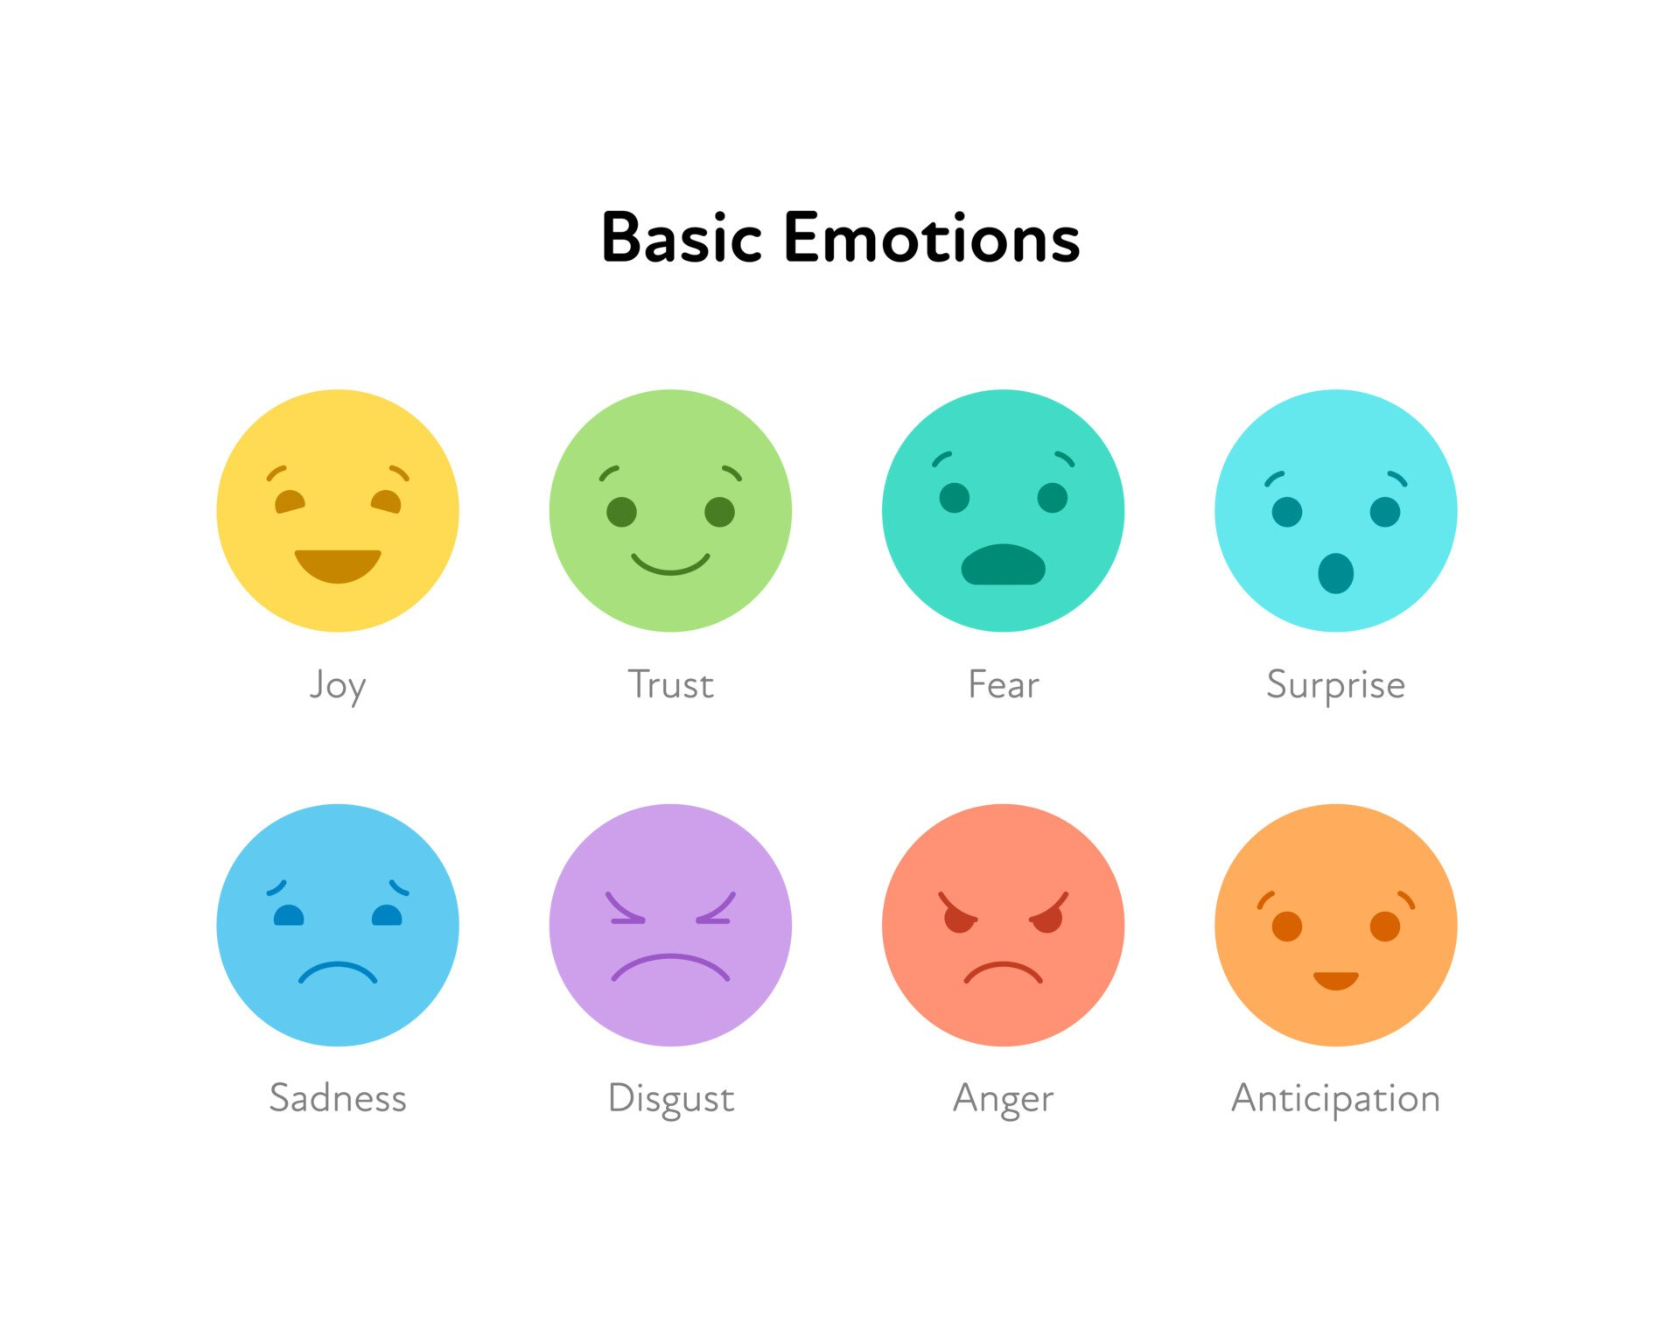
Basic EMOTIONS

Slide 8
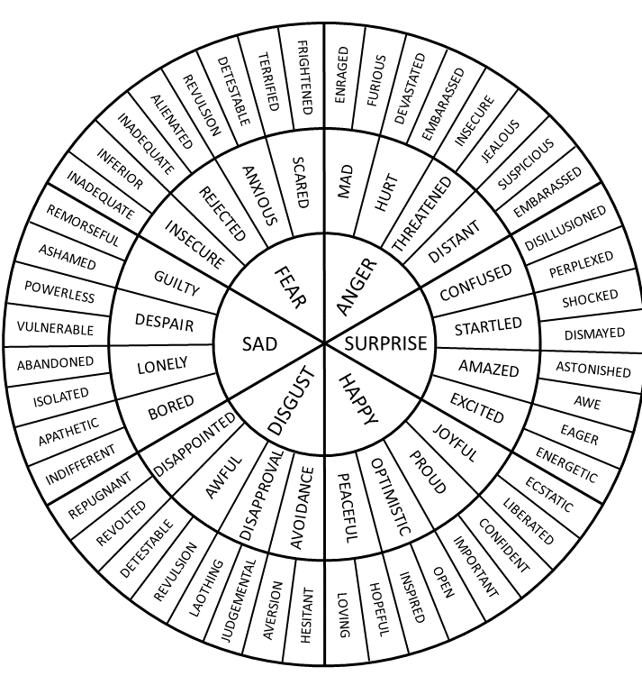
WHAT ARE “NORMAL” EMOTIONS?

Slide 9
HOW DO WE MANAGE OUR EMOTIONS?

Slide 10

Identifying the TRIGGERING EMOTION?

Slide 11
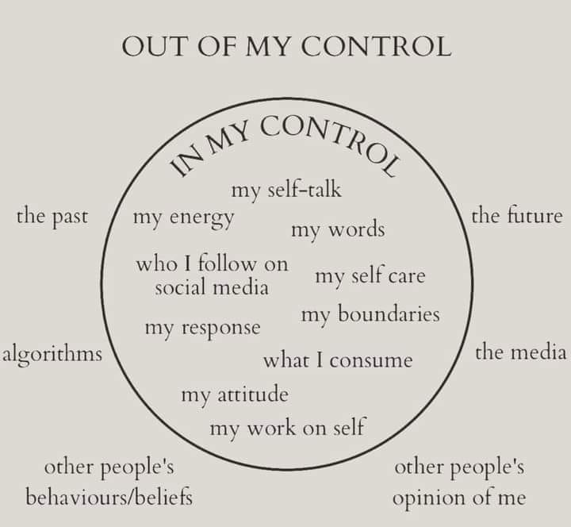
CONTROL VS. OUT OF OUR CONTROL

Slide 12
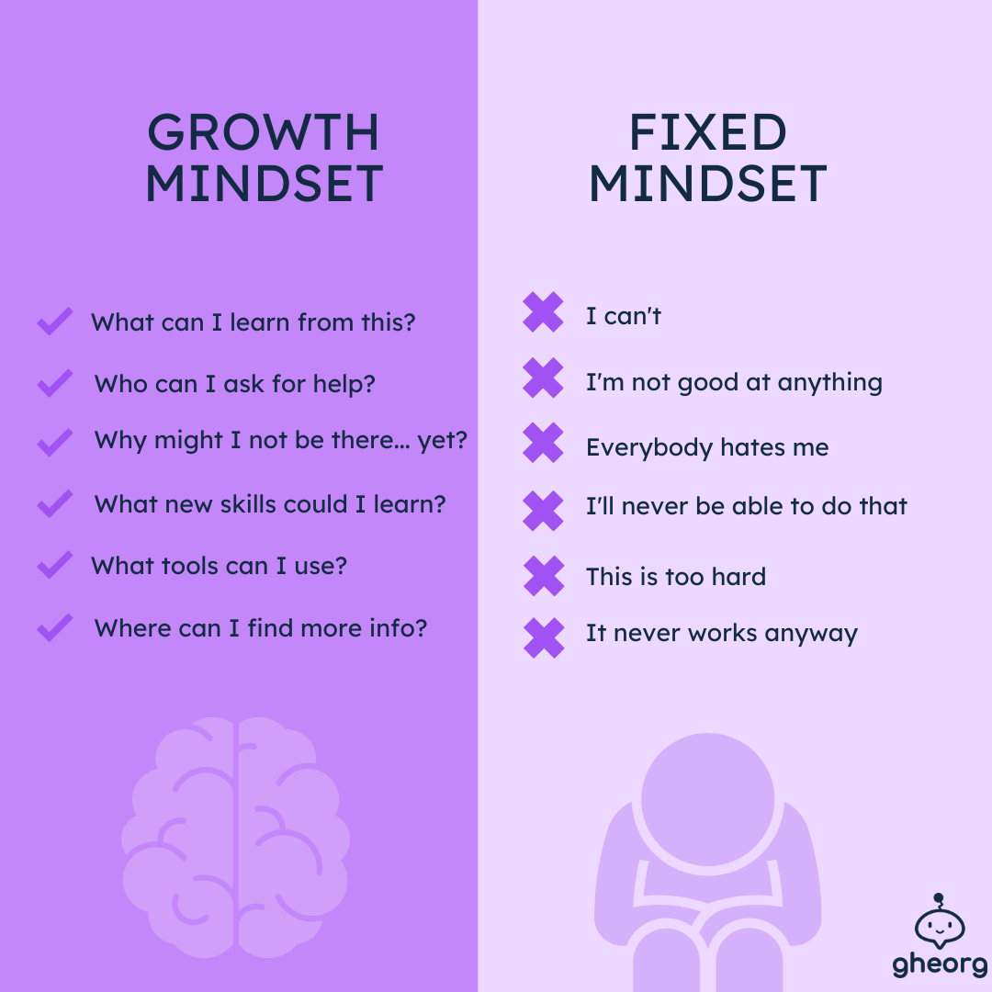
FIXED MINDSET VS. GROWTH MINDSET

Slide 13
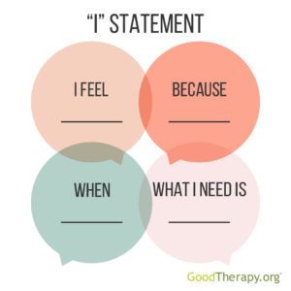
“I” Statement
You’ statements:
“You always leave your mess lying everywhere.”
“You don’t care about me or my feelings.”
“You didn’t text me like you said you would.”
“You embarrassed me at dinner the other night, like you always do.”
“You never tell me how you’re feeling.”
‘I’ statements:
“I feel frustrated when I come home and the house is messy.”
“I feel frustrated when my feelings aren’t heard or acknowledged.”
“I feel worried when I don’t hear from you, and I just want to know that you’re ok and safe.”
“I felt really embarrassed the other night in front of our friends when this topic came up, because…”
“I would love to know how you’re feeling about this.”

Slide 14
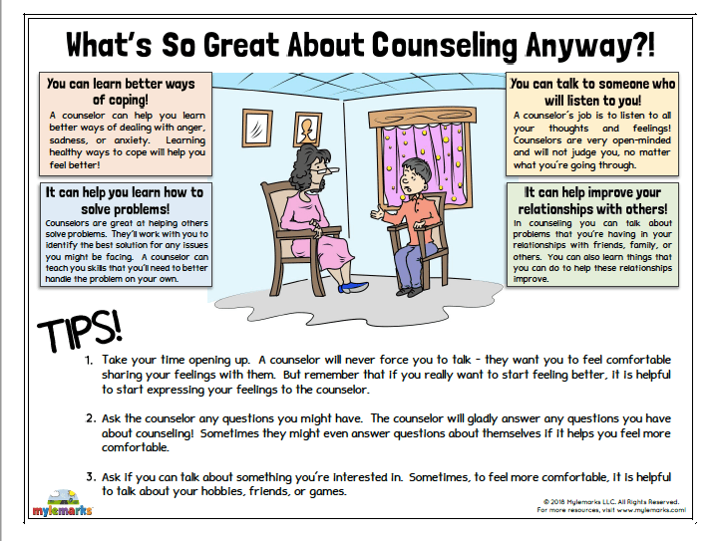

Slide 15
REFERENCE
www.montrealcbtpsychologist.com

